Slide 1


Q-Point Stability For Transistors
PRESENTED BY :- ARYAN DILIPBHAI LANGHANOJA
ENROLLMENT -NO :- 92200133030

Slide 2
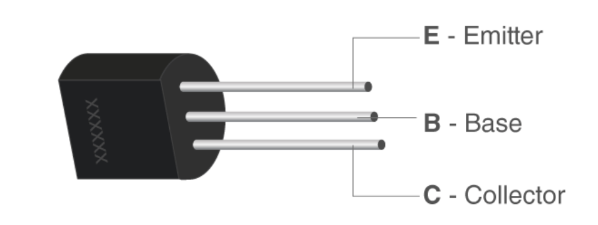
Parts Of Transistors
A typical transistor is composed of three layers of semiconductor materials or more specifically terminals which helps to make a connection to an external circuit and carry the current. A voltage or current that is applied to any one pair of the terminals of a transistor controls the current through the other pair of terminals. There are three terminals for a transistor. They are:-
Base: - This is used to activate the transistor.
Collector: - It is the positive lead of the transistor.
Emitter: - It is the negative lead of the transistor.

Slide 3
Thickness and Doping of Emitter, Base and Collector
 | Thickness | Doping
Emitter | Wide | Heavily Doped
Collector | More Wide than Emitter | Moderately Doped
Base | Very Thin | Lightly Doped

Slide 4
Types Of Transistors
Transistors
BJT
N-P-N
P-N-P
FET

Slide 5
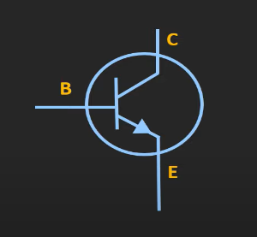
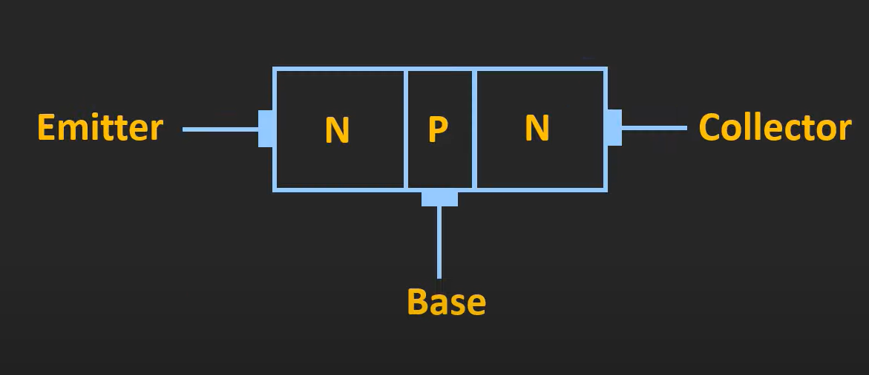
N-P-N Transistor
Symbol In Circuit

Slide 6
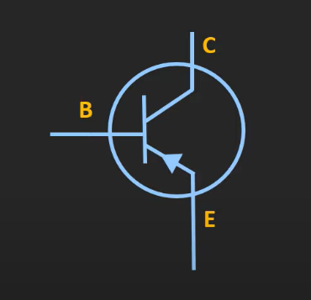
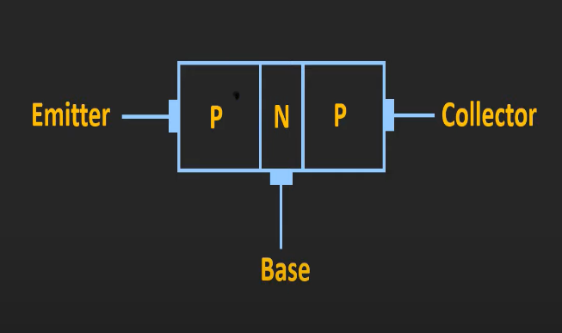
P-N-P Transistor
Symbol In Circuit

Slide 7
Transistors Configuration
There Are Three Types Of Transistors Configuration-
Common Emitter Transistor (CE)
Common Base Transistor (CB)
Common Collector Transistor (CC)

Slide 8
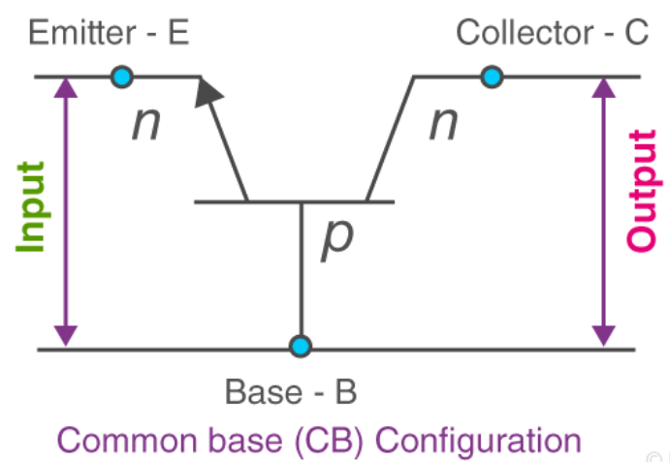
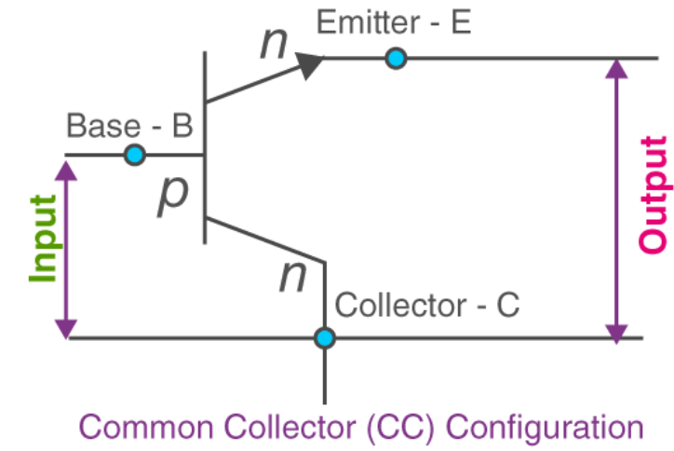
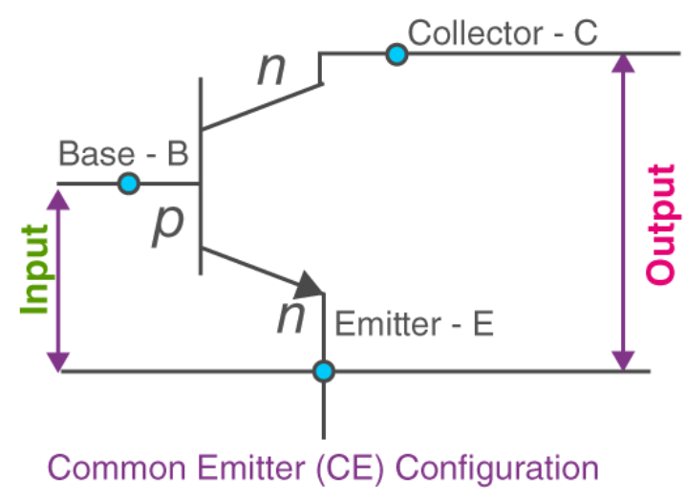

Slide 9
Region Of Operation
There Are Four Different types of Operating Regions for transistors:-
Active Region.
Cut-Off Region.
Saturation Region.
Reverse Active Region.

Slide 10
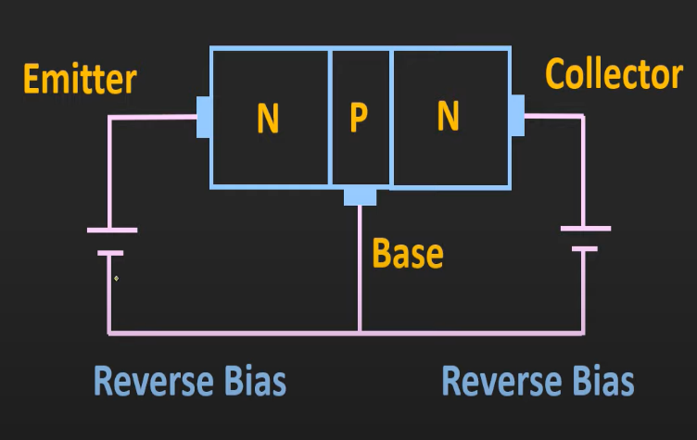
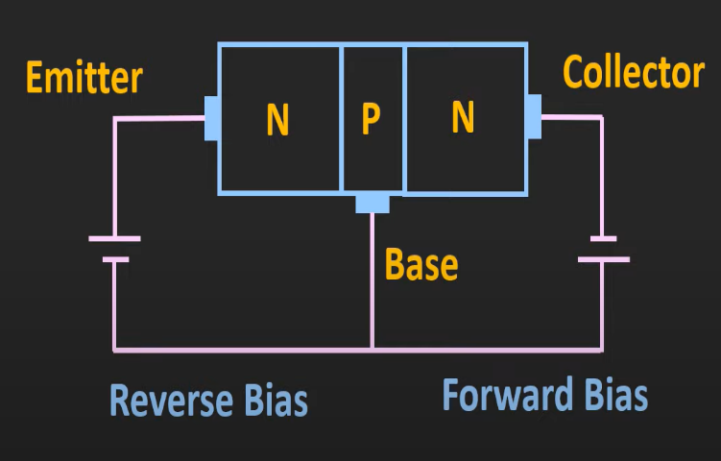
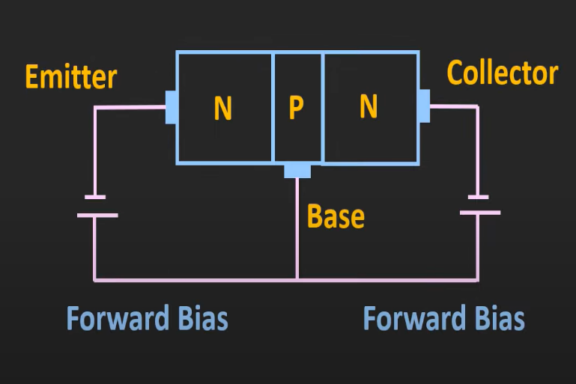
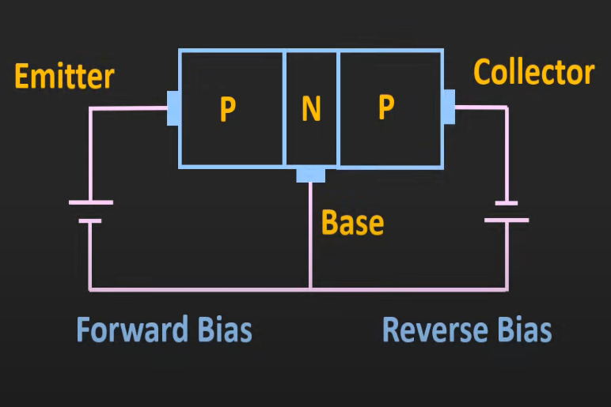
1) Cut-Off Region
2) Reverse-Active Region
3) Saturation region
4) Active Region

Slide 11
TYPES OF BIASING
There Are Four Types Of Transistor Biasing.
Fix Biased
Fix Biased With Emitter Resistor
Collector to Base Bias
Voltage Divider Bias
Emitter Bias

Slide 12
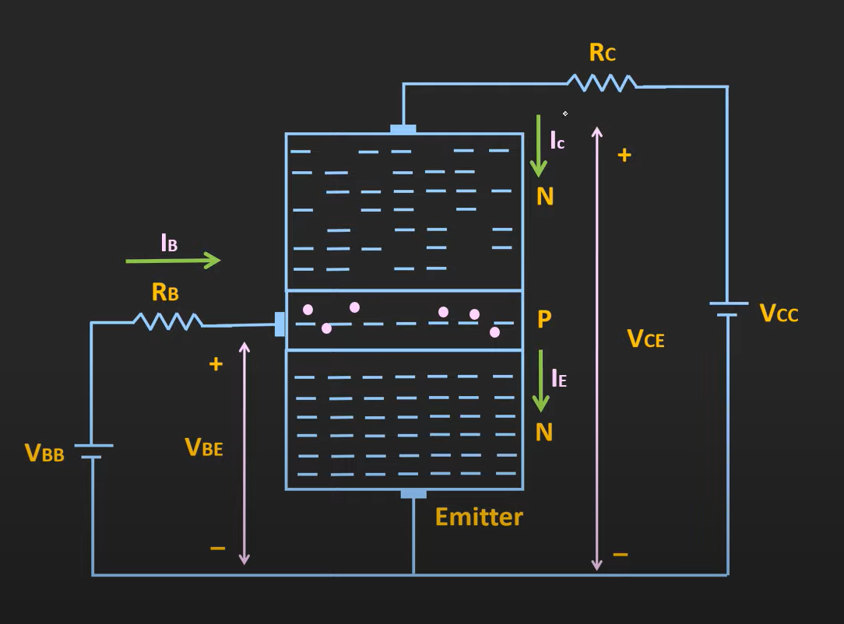
FIX-BIAS
In This Figure, Shown that Voltage Given at Base-Emitter Junction is VBB and Voltage Given at Emitter-Base Junction is VEE. We are using active Region of operation.
When we applied Voltage at Emitter, Emitter emits lot of free electron, because it is heavily doped. That Electron Enters in Base. Where some holes are present. And electron combines with them.
Now electron has two choices, go to VBB or to go VCC. Because VCC>>VBB. Some electrons are attracted by VBB and rest all electron is attracted by the VCC. And it is shown that the current is I_{C} due to that. And the current I_{B} is the current produces by the electron attracted by the VBB.

Slide 13
Now, applying KCL,
I_{E =} I_{B} + I_{C}
As already mentioned that very few electron attracted by VBB
I_{B} ≈ 0 and I_{C} ≈ I_{E}
∴
Now ,
∴ I_{E =} I_{B} + α I_{E}
∴ I_{B =} I_{E} - α I_{E}
∴I_{B =} I_{E} - α I_{E}
∴I_{B =} (1- α) I_{E}
Putting I_{E} = I_{C} / α .
∴I_{B =} (1- α) I_{C} / α .
∴ I_{B =} (1- α/ α) I_{C} .
∴ I_{C} = (α/1- α)I_{B} .
∴ I_{C} = (α/1- α)I_{B}
∴
Where β is called the current gain.
I_{C} = α I_{E}
Ic = βI_{B}

Slide 14
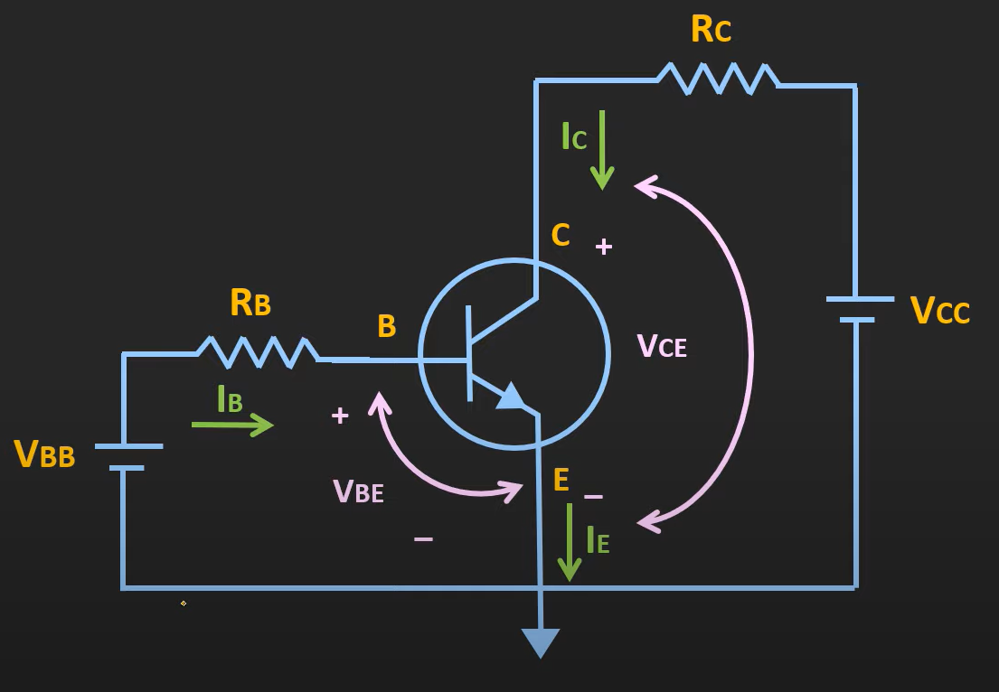
Now, if we took Emitter-Base Loop and apply
KVL in it,
∴ V_{BB}- I_{B}R_{B} – V_{BE} = 0.
∴
And Now, if we took Collector-Base Loop and apply
KVL in it,
V_{CC} -I_{C}R_{C} – V_{CE} = 0.
I_{B} = V_{BB} – V_{BE} R_{B}
∴ V_{CE} = V_{CC} -I_{C}R_{C}

Slide 15
Observation Table
VCC | RC | IC | VCE
12 V | 1 K Ω | 11.902 mA | 0.098 V
12 V | 1.01 KΩ | 11.784 mA | 0.09816 V
12 V | 1.02 KΩ | 11.669 mA | 0.09762 V
12 V | 1.03 KΩ | 11.556 mA | 0.09732 V
12 V | 1.04 KΩ | 11.446 mA | 0.09616 V

Slide 16
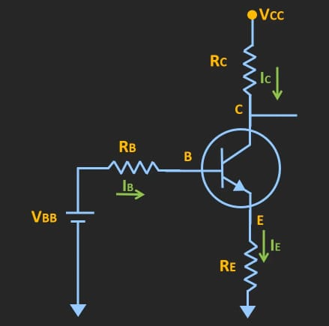
Fix Bias With Emitter Resistor
In this condition, the Emitter Resistor R_{E} will act as a feedback resistor. In any situation, temperature changes, then β changes. Let suppose the temperature increases, then β increases, and for the fix current I_{B}, Collector Current I_{C} will increases. Then the voltage drop across emitter Resistor will also increase. and base voltage V_{BE} will also increase. And because of V_{BE} increased V_{B} is also increased and I_{B} will decrease. And Q-point will be stable.

Slide 17
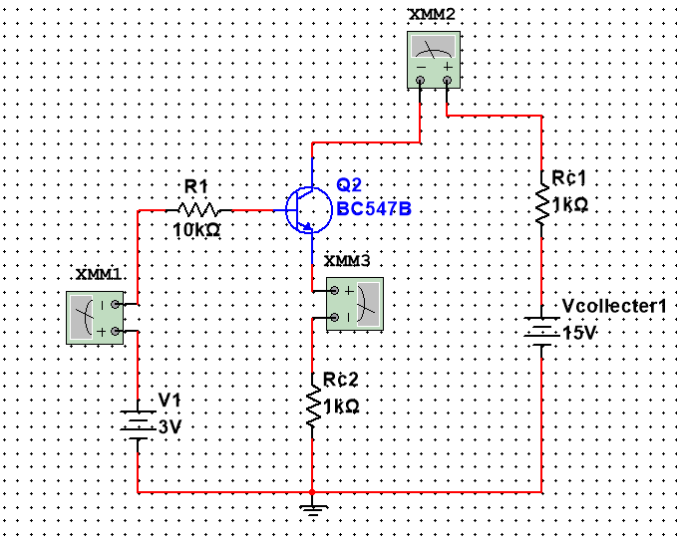
Now, if we took Emitter-Base Loop and apply KVL in it,
∴ V_{BB}- I_{B}R_{B} – V_{BE} – I_{E}R_{E} = 0.
∴ V_{BB}- I_{B}R_{B} – V_{BE} – I_{E}R_{E} = 0.
∴ V_{BB}- I_{B}R_{B} – V_{BE} – (I_{B} + I_{C})R_{E} = 0.
∴ V_{BB}- I_{B}R_{B} – V_{BE} – (I_{B} + βI_{B} )R_{E} = 0.
V_{BB}- I_{B}R_{B} – V_{BE} – (1 + β )I_{B}R_{E} = 0.
And Now, if we took Collector-Base Loop and
apply KVL in it,
∴V_{CC} -I_{C}R_{C} – V_{CE} - I_{E}R_{E} = 0.
∴
I_{B} = V_{BB} - V_{BE} R_{B} + (β + 1) R_{E}
V_{CE} = V_{CC} –I_{C}(R_{C} + R_{E})

Slide 18
Observation Table
VCC | RC | IC | VCE
12 V | 1 KΩ | 2.287 mA | 9.713 V
12 V | 1.01 KΩ | 2.287 mA | 9.69013 V
12 V | 1.02 KΩ | 2.287 mA | 9.66726 V
12 V | 1.03 KΩ | 2.287 mA | 9.64439 V
12 V | 1.04 KΩ | 2.287 mA | 9.62152 V

Slide 20


